Slide 1
SIRX Model-Ebola in West Africa
Project proposal: Reid Blouin

Slide 2
Systems of Study
Using a SIRX Model
Study the changes in Various Populations
S- Susceptible Population
I-Infected Population
R-Recovered Population
X-Dead Population

Slide 3
Benefits to Empirical Models
Provide strong insight into how diseases are transmitted
Public Health Concerns & Control effects
Ebola, Cholera, Plague
Models date back to Early 20th Century
Allows us to focus on different time periods of virus outbreak
Focus on Ebola over a longer period of time

Slide 4
Question’s to Study
The strength of my interaction variables
How the spread of Ebola occurs & how a susceptible population changes
S’=-β*S*I
The rate at which and infected population grows
I’= +β*S*I
The rate at which an infected population recovers or dies
R’=+ Ζ *I
X’= + α *I

Slide 5
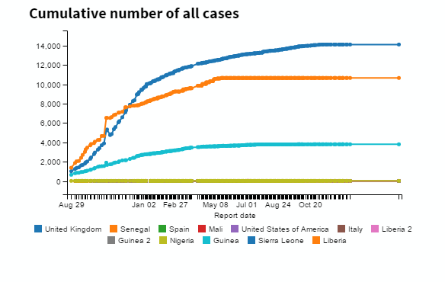
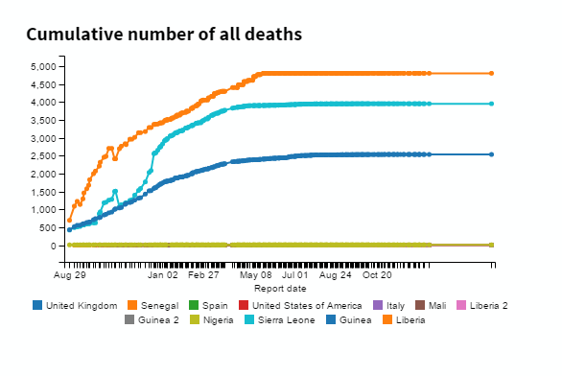
Data Set-2014 Ebola Virus- West Africa
Data set examined Ebola for countries in North America, Europe, Africa
Examined Cumulative Cases, Cumulative Deaths
Suspected & confirmed Cases & Deaths
From August 29th 2014- January 6th, 2016

Slide 6
Guinea Pyndamics Implementation
sim=Simulation()
sim.add("S'=-beta*S*I",25000,plot=1)
sim.add("I'=beta*S*I-zeta*I-alpha*I",650,plot=2)
sim.add("R'=zeta*I",0,plot=3)
sim.add("X'=alpha*I",0,plot=4)
sim.add("C=I+R+X",plot=5)
sim.params(beta=6.28e-7,zeta=.005,alpha=.012)
sim.add_data(t=t_data,X=X_data,plot=True)
sim.add_data(t=t_data,C=C_data,plot=True)
sim.run(0,700)

Slide 7
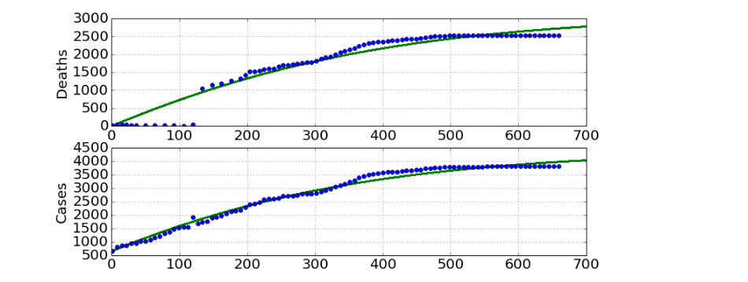
Predictions

Slide 8
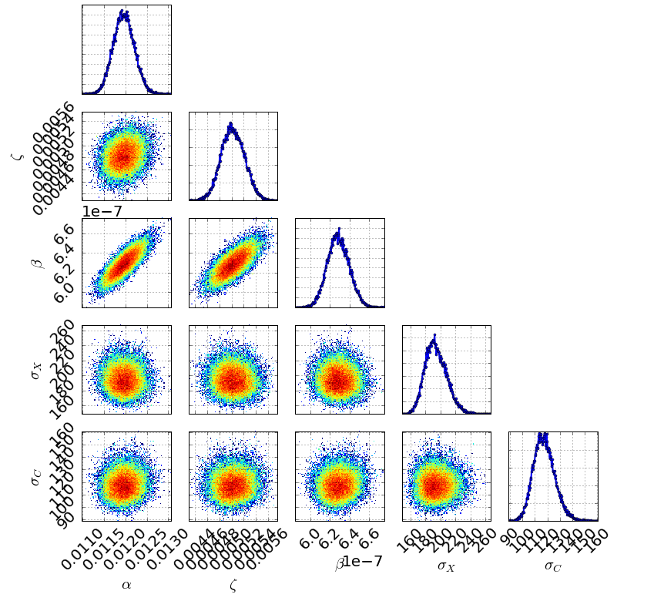
Triangle Plot

Slide 9
Sierra Leone-Initial Pyndamics
sim=Simulation()
sim.add("S'=-beta*S*I/25000",25000,plot=True)
sim.add("I'=beta*S*I-zeta*I-alpha*I",1000,plot=True)
sim.add("R'=zeta*I",0,plot=True)
sim.add("X'=alpha*I",0,plot=True)
sim.add("C=I+R+X",plot=True)
sim.params(beta=1.68e-6,zeta=.031,alpha=.013)
sim.add_data(t=t_data,X=X_data,plot=True)
sim.add_data(t=t_data,C=C_data,plot=True)
sim.run(0,700)

Slide 10
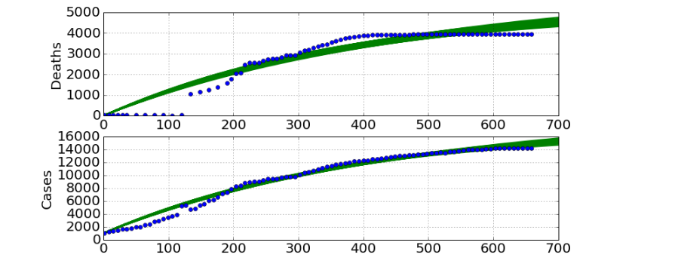
Sierra Leone Predictions

Slide 11
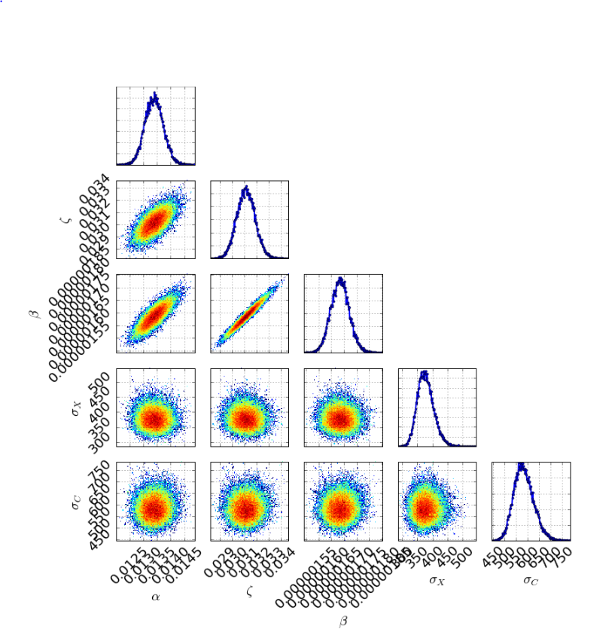
Triangle Plots

Slide 12
Estimated Parameters & Uncertainties
Guinea β=6.28e-7 (+2.02e-8) (–2.08e-8)
Guinea α=.005 + or (–0.000)
Guinea ζ=0.12+ or (–0.000)
Sierra β=1.68e-06 (+7.26e-8) (–6.95e-8)
Sierra α=.013 + (.001) (–.002)
Sierra ζ=0.031 (+.002) (–.001)

